Slide 1

CRICKET LIVE ALERTS
PYTHON PROJECT
This Photo by Unknown author is licensed under CC BY.

Slide 2

Project Details :
UNDER THE GUIDANCE OF: MOHAMMAD MISKEEN ALI
GROUP 13 DETAILS:-
1-DHEERJ PULIME AP21110010935
2-GANESH SESHA SAI AKHIL AP21110010931
3-VRIJESHWAR SINGH AP21110010922
4-SAI AKASH PATNANA AP21110010945
This Photo by Unknown author is licensed under CC BY-NC-ND.

Slide 3

AGENDA
1-Introduction
2-Aim of the object
3-Abstract
4-technology used
4-Methodology
5-modules used
6-running code
7-output
8-conclusion
9-references
This Photo by Unknown author is licensed under CC BY-SA.

Slide 4

INTRODUCTION
Cricket fans, raise your foam fingers if you have been looking for a quicker way to share scores and updates with your friends. Even if you aren’t a sports enthusiast, think about the number of fans who are out there looking for an option like this on their phones. Sports websites do offer live scores on their page which is what the majority of the people follow to stay updated on live updates if they are not watching a match.
But the thing with these websites is that you have to keep staring at the page or refreshing it to get the latest score which can be quite unproductive if you are in the middle of important work. Moreover, every time you want to share the joy of a SIX or a wicket with your friend, you have to manually share it via a messaging app.
But now, you can build a better solution for the millions of sports fans (including yourself if you raised your foam finger) and even learn important concepts in that process.
This Photo by Unknown author is licensed under CC BY-NC-ND.

Slide 5

AIM OF THE PROJECT
The objective of the project is to display live cricket score alerts in python. In this project, live cricket data is fetched from the network and it will be shown in our project. You’ll get all the live match details from this project like team name, live score, location, time.

Slide 6

ABSTRACT
The project Cricket alerts is the best source to get updated with the live matches.
let us dive into the features of this project, this project is comprised of the class which having some methods. The output of this project is very simpler form
it shows the user all the current live matches ,user has to select the match by entering the serial number of the desired match, one gui get opened on the desktop it will be having complete description of the match including score. After every 20 seconds new updated gui will get opened.
This project involving the web scrapping techniques. The match will get selected by the user, that match's data will get scraped from the website and display to the user. This project is user-friedly, it dosen't involves too many selections.
This Photo by Unknown author is licensed under CC BY-SA.

Slide 7

TECHNOLOGY :
Language: Python
IDLE : Python PIP
Operating System : Windows 11
Processors : Intel Core i5 processor
Disk space : 3 to 4 GB.
Python Version : Python 3.9.8
This Photo by Unknown author is licensed under CC BY-SA.

Slide 8

METHODOLOGY
class created :
Cricketinfo() - This class contains all required methods
functions used:
disply_score() - function to dispaly the gui of named 'my score board',which
contains the score .
live_matchs_details - function to scrap the details of the
live matches from the website,and also
it display the list of the current matches
the current matches.
This Photo by Unknown author is licensed under CC BY-SA.

Slide 9
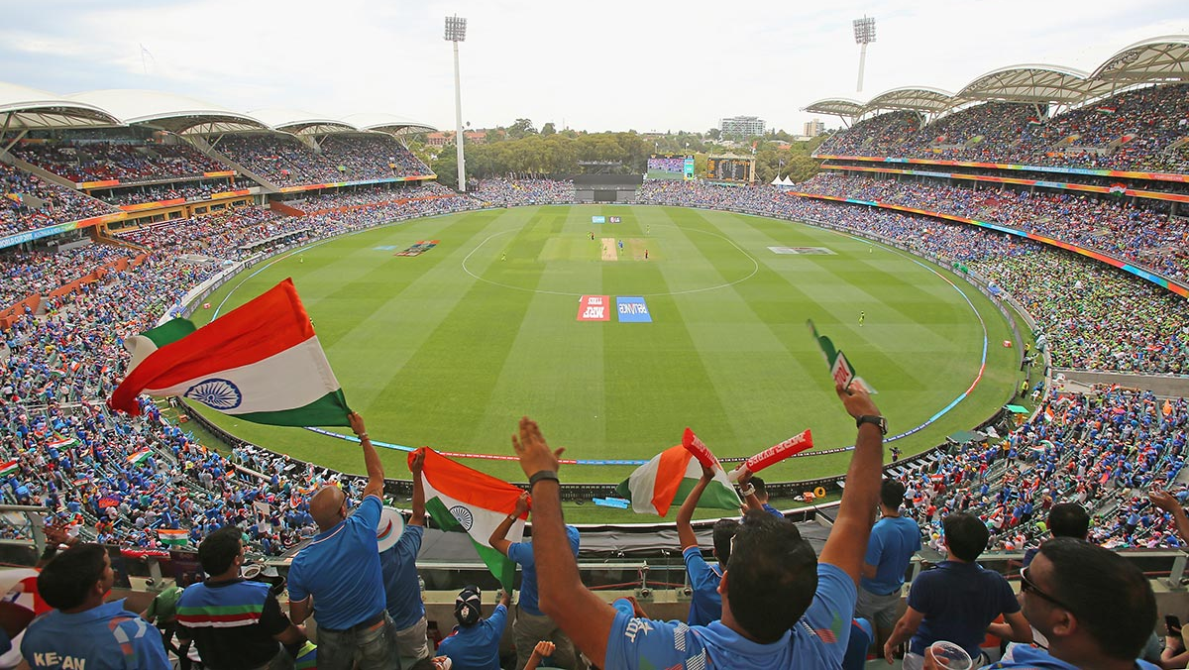
validate_user_input()- function to get the input from the user
and validating the interfering erros with
exception handlings.
get_live_matchs() - function to evaluate and scrap the details
of user selected match.
This Photo by Unknown author is licensed under CC BY-NC-ND.

Slide 10
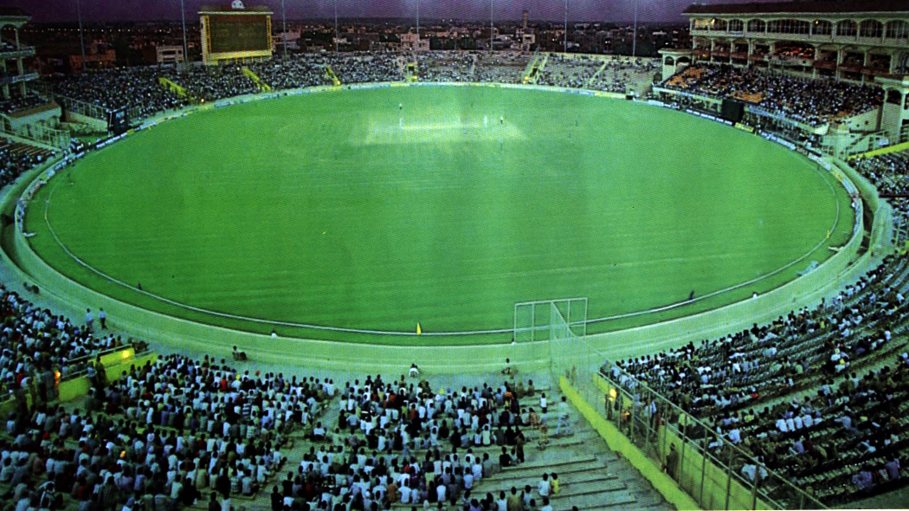
MODULES USED:
1-SYS MODULE
2-REQUESTS
3-TIME MODULE
4-BOOTSTRAP(BS4)
This Photo by Unknown author is licensed under CC BY-SA.

Slide 11
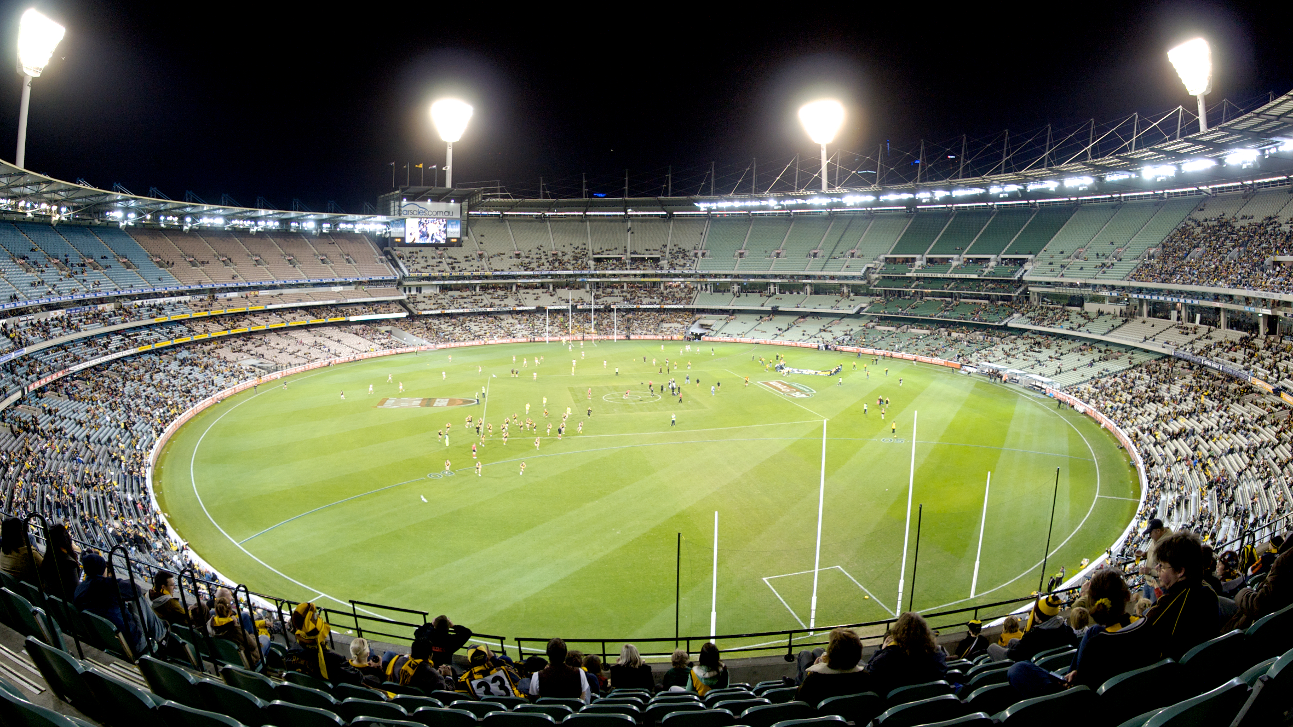
CODE :
import sys
import warnings
import requests
from time import sleep
from bs4 import BeautifulSoup
warnings.filterwarnings('ignore')
from tkinter import Tk
from tkinter.messagebox import Message
from _tkinter import TclError
class Cricketinfo:
def __init__(self):
self.url = "http://static.cricinfo.com/rss/livescores.xml"
def display_score(self,score):
This Photo by Unknown author is licensed under CC BY-SA.

Slide 12
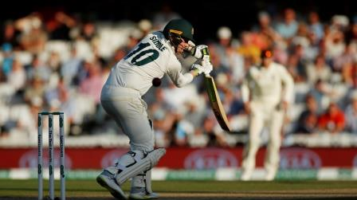
TIME_TO_WAIT = 20000 # in milliseconds
root = Tk()
root.withdraw()
try:
root.after(TIME_TO_WAIT, root.destroy)
Message(title="your title", message=score,
master=root).show()
except TclError:
pass
def live_matchs_details(self):
sno = 1
match_guid = []
response = requests.get(self.url)
soup = BeautifulSoup(response.text,'lxml')
print('\n\n=====================')
print('Live Cricket Matches:')
print('=====================\n')
This Photo by Unknown author is licensed under CC BY-NC.

Slide 13

for item in soup.findAll('item'):
print(str(sno) + '. ' + item.find('description').text)
match_guid.append(item.find('guid').text)
sno = sno + 1
return match_guid
def validate_user_input(self):
print('Enter match number or enter 0 to exit:')
while True:
try:
userInput = int(input())
except NameError:
print('Invalid input. Try Again!’)
continue
except SyntaxError:
print('Invalid input. Try Again!')
This Photo by Unknown author is licensed under CC BY-SA-NC.

Slide 14

if userInput < 0 or userInput > 30:
print('Invalid input. Try Again!')
continue
elif userInput == 0:
sys.exit()
return userInput
def get_live_matchs(self):
match_guid= self.live_matchs_details()
userInput = self.validate_user_input()
try:
while True:
matchUrl = match_guid[userInput - 1]
r = requests.get(matchUrl)
soup = BeautifulSoup(r.text,'lxml')
score = soup.findAll('title')
This Photo by Unknown author is licensed under CC BY-SA.

Slide 15

try:
r.raise_for_status()
except Exception as exc:
print ('Connection Failure. Try again!')
continue
self.display_score(score[0].text)
except KeyboardInterrupt:
print('interrupted!')
m=Cricketinfo()
m.get_live_matchs()

Slide 16
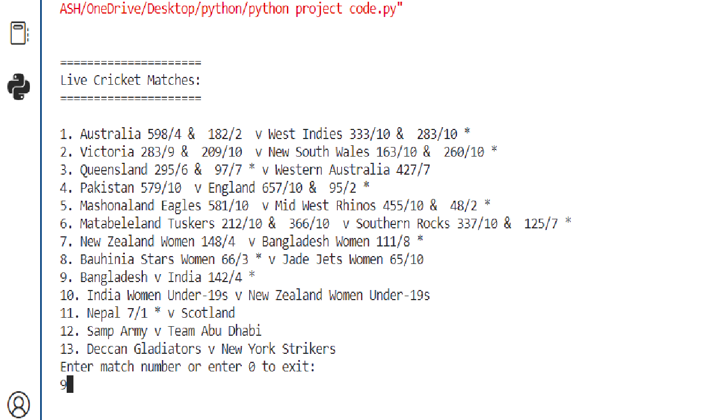
Output

Slide 17
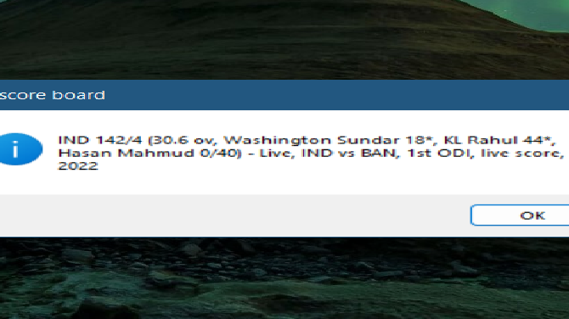

Slide 18

CONCLUSION :
We have successfully developed the project of cricket alerts in python that will display the live score.
we came across the installation of the different modules to our idle.
we learnt how to use tkinter module to make GUI to display the score.
we learnt how to use requests moule to scrap the data from the different websites
And from bs4 module, we understood the usage of Beautifulsoup function and how to convert the unstructured data into the structured xml format.
we came across the exception handlings, we implemented exception hanlings
In requried areas.And also we learnt about the time and sys modules.
Also, we learned how to scrap the live data from any website and refine it for use.
This Photo by Unknown author is licensed under CC BY.

Slide 19

THANK
YOU
This Photo by Unknown author is licensed under CC BY-SA.

